Slide 1


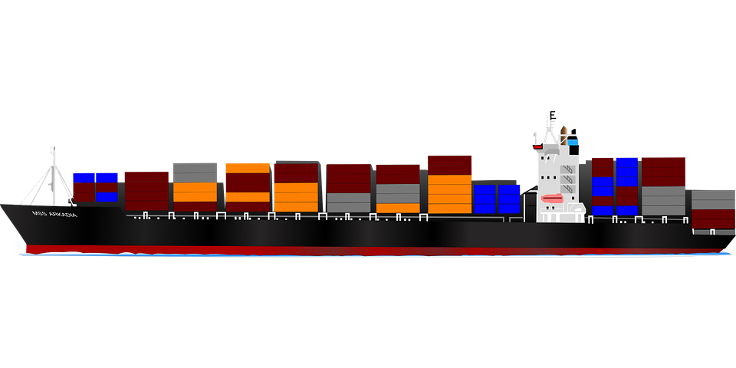
Who We Are
The Maryland Port Administration oversees the Port of Baltimore, which represents one of the biggest commercial shipping hubs in the United States.
2019 recorded $15 billion in exports and $43 billion in imports (13th and 9th place nationally)
Trading partners throughout six continents
2019 recorded 8.2 million tons of container cargo
United States’ second biggest vehicle handler
We aim to optimize operations by bringing this major port to the 21st century.
Notes:
Sources: https://mpa.maryland.gov/Documents/2019FCSR.pdf
https://en.wikipedia.org/wiki/Port_of_Baltimore

Slide 2
Our Proposed Solution
Creating a Single View
Optimizing Traffic Control
Describing and Predicting
The Future and Beyond
We aim to create a single repository by implementing a star-schema to outline who the stakeholders are, what products are being shipped, and tracking relevant date-time measures. We aim to provide a demo of a pseudo use case to propose how this can be implemented using ETL.
We strive to create reliable and easily-accessible data to provide traffic reports to optimize the flow of goods. Real-time geospatial and date-time data can allow for up-to-date queries at a moment’s notice.
In addition to using analytics to describe the current state of our business, we can use forecasting models to determine future business practices.
Engaging in this digital transformation will be the first step in achieving a truly ‘smart’ port. One where AI and IoT can create autonomous operations.
Notes:
1 - Basically just creating the data warehouse/star schema (building the schema/technical overview)
2 - Our end goal would be using our concept to implement a detailed real-time tracker in the future (better, more informative queries)
3 - Explaining how we are creating simple descriptive dashboards (commerce by logistics company, by country), but we can also build upon this by using our initial data insights forecast future commerce insights (e.g. how do the biggest logistics companies affect the smaller ones in the future) (dashboarding descriptive and predictive analytics)
4 - outline how getting this initial digital transformation could be the stepping stones to even more interesting future achievements. (Future proposal)

Slide 3
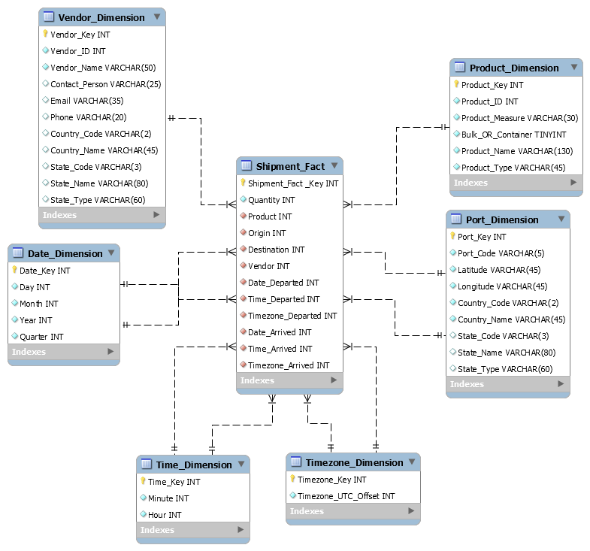
Data warehouse - Star Schema
Notes:
1 - Basically just creating the data warehouse/star schema (building the schema/technical overview)
2 - Our end goal would be using our concept to implement a detailed real-time tracker in the future (better, more informative queries)
3 - Explaining how we are creating simple descriptive dashboards (commerce by logistics company, by country), but we can also build upon this by using our initial data insights forecast future commerce insights (e.g. how do the biggest logistics companies affect the smaller ones in the future) (dashboarding descriptive and predictive analytics)
4 - outline how getting this initial digital transformation could be the stepping stones to even more interesting future achievements. (Future proposal)

Slide 4
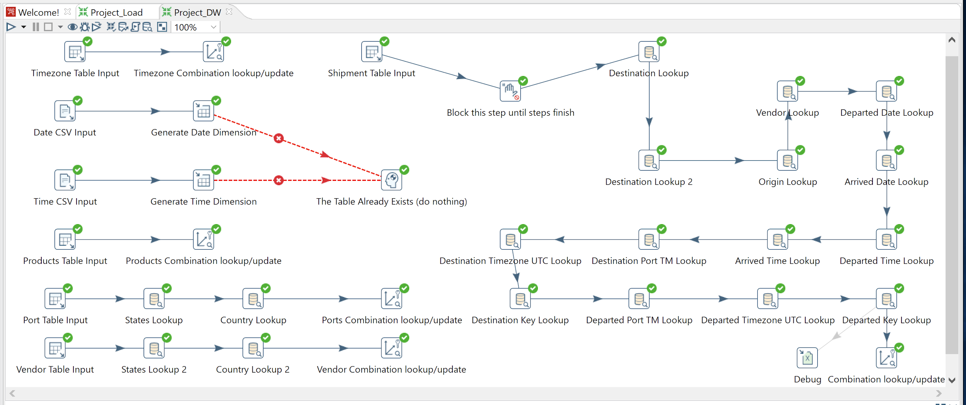
Data Integration - ETL
Notes:
1 - Basically just creating the data warehouse/star schema (building the schema/technical overview)
2 - Our end goal would be using our concept to implement a detailed real-time tracker in the future (better, more informative queries)
3 - Explaining how we are creating simple descriptive dashboards (commerce by logistics company, by country), but we can also build upon this by using our initial data insights forecast future commerce insights (e.g. how do the biggest logistics companies affect the smaller ones in the future) (dashboarding descriptive and predictive analytics)
4 - outline how getting this initial digital transformation could be the stepping stones to even more interesting future achievements. (Future proposal)

Slide 5
Conclusion and future scope
Digital Transformation as a Stepping Stone
Revitalize Supply-Chain Infrastructure for the USA
To Infinity and Beyond
Notes:
1 - Basically just creating the data warehouse/star schema (building the schema/technical overview)
2 - Our end goal would be using our concept to implement a detailed real-time tracker in the future (better, more informative queries)
3 - Explaining how we are creating simple descriptive dashboards (commerce by logistics company, by country), but we can also build upon this by using our initial data insights forecast future commerce insights (e.g. how do the biggest logistics companies affect the smaller ones in the future) (dashboarding descriptive and predictive analytics)
4 - outline how getting this initial digital transformation could be the stepping stones to even more interesting future achievements. (Future proposal)

Slide 6
Thank you!
Questions?

Slide 7
Backup Slides

Slide 8
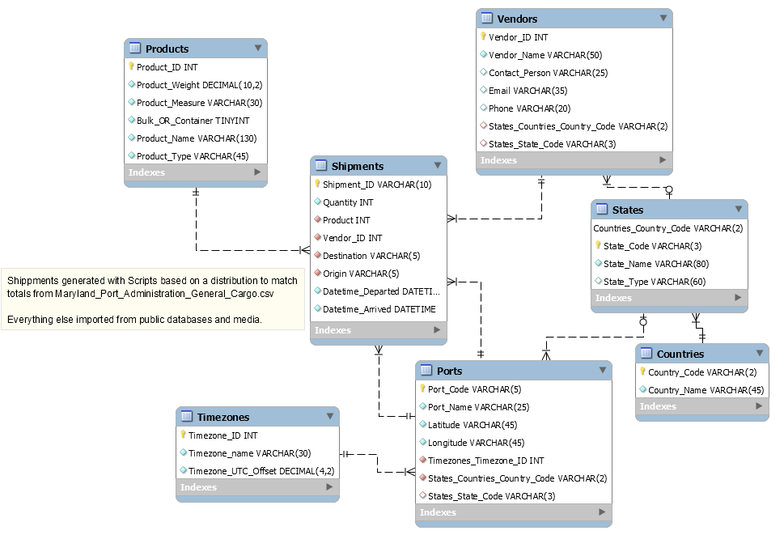
ER Model
Notes:
1 - Basically just creating the data warehouse/star schema (building the schema/technical overview)
2 - Our end goal would be using our concept to implement a detailed real-time tracker in the future (better, more informative queries)
3 - Explaining how we are creating simple descriptive dashboards (commerce by logistics company, by country), but we can also build upon this by using our initial data insights forecast future commerce insights (e.g. how do the biggest logistics companies affect the smaller ones in the future) (dashboarding descriptive and predictive analytics)
4 - outline how getting this initial digital transformation could be the stepping stones to even more interesting future achievements. (Future proposal)

